Slide 1



Nicox Corporate Presentation
An international ophthalmology company developing innovative solutions to help maintain vision and improve ocular health
September 23, 2024
Euronext Growth Paris: ALCOX
September 2022

Slide 2
Forward-looking statements
This document has been prepared by Nicox SA and may not be reproduced or distributed, in whole or in part. The information contained in this document has not been independently verified and no representation, warranty or undertaking, expressed or implied, is made as to, and no reliance should be placed on, the fairness, accuracy, completeness or correctness of the information or opinions contained herein.
The information contained in this document may be modified without former notice. This information includes forward-looking statements. Such forward-looking statements are not guarantees of future performance. These statements are based on current expectations or beliefs of the management of Nicox SA and are subject to a number of factors and uncertainties that could cause actual results to differ materially from those described in the forward-looking statements. Nicox SA and its affiliates, directors, officers, employees, advisers or agents, do not undertake, nor do they have any obligation, to provide updates or to revise any forward-looking statements.
None of Nicox SA nor any of its affiliates, directors, officers, employees, advisers or agents, shall have any liability whatsoever (in negligence or otherwise) for the use of these materials by any person or for any loss arising from any use of this document or its contents or otherwise arising in connection with this document. It is not the purpose of this document to provide, and you may not rely on this document as providing, a complete or comprehensive analysis of the Company’s financial or commercial position or prospects.
This document is not intended for potential investors and does not constitute or form part of, and should not be construed as an offer or the solicitation of an offer to subscribe for or purchase securities of the Company, and nothing contained herein shall form the basis of or be relied on in connection with any contract or commitment whatsoever.
Risk factors which are likely to have a material effect on Nicox SA’s business are presented in section 3 of the “Rapport Annuel 2023” which is available on Nicox SA’ website (www.nicox.com).
This presentation may contain links or references to websites operated by other parties. The linked sites are not under the control of Nicox SA, and Nicox SA is not responsible for the data protection strategies or the content available on any other Internet sites linked from our website. Such links do not imply Nicox SA’ endorsement of material on any other site, and Nicox SA disclaims all liability with regard to your access to such linked websites. Nicox SA provides links to Internet sites as a convenience to users, and access to any Internet sites linked to or mentioned in this presentation is at your own risk.

Slide 3
Progress in achieving value inflection points expected for 2024-2025
1
Recent Highlights
Appointment of Gavin Spencer as Chief Executive Officer
Nicox Board entirely renewed with appointment of Damian Marron as Chair and 3 new Board members
Restructuring of debt agreements with BlackRock
Streamlining costs to concentrate on NCX 470 clinical development
Equity financing of €3.3 million
Value proposition of NCX 470 confirmed through Kowa partnership
Completion of recruitment of U.S. patients in the Denali trial
Approval of ZERVIATE in China
Research and licensing option agreement with Glaukos for NCX 1728
2
Strategic Horizons
ZERVIATE Launch in China
Denali results in 2025 to crystallize NCX 470 strategic value
Business development and partnerships
Potential strategic transactions

Slide 4
Consistently delivering innovations in ophthalmology …
… with NCX 470 the next derisked asset advancing toward NDA filing in the U.S. and China
Commercial value of lead asset NCX 470 in late-stage Phase 3 development
Global partnerships with
Tier 1 ophthalmology players
Deep ophthalmology experience
A potentially differentiated profile targeting ~$6bn worldwide glaucoma market
Positive results from the first Phase 3 trial¹, Mont Blanc, demonstrating competitive
IOP-lowering properties
Additional benefits, e.g. retinal, seen in nonclinical models^{2,3} to be explored post-Phase 3
Continued sales growth of VYZULTA® by Bausch + Lomb (+12% reported for Q2 2024)
Partnerships for NCX 470 in Japan with Kowa and in China with Ocumension Therapeutics
Recent approval of ZERVIATE in China, part of multi-product collaboration with Ocumension
Research and option agreement with Glaukos for NCX 1728
Two FDA approved products
Extensive development expertise has generated a focused portfolio of products and product candidates
Business and corporate development track record, including M&A
Nicox Press release October 31, 2022
Bastia et al., J Ocul Pharmacol Ther. 2022, 38: 496-504
Sgambellone et al., Transl Vis Sci Technol. 2023, 1;12(9):22.

Slide 5
Upcoming milestones
Several positive milestones in 2024 and 2025
NCX 470
ZERVIATE
Corporate
Denali results – H2 2025
Whistler results – Q1 2025
Estimated worldwide sales over $300 million¹
Upcoming launch in China
Ongoing business development discussions
Potential NCX 1728 license option with Glaukos
Within 8 years of launch in the U.S. and China

Slide 6

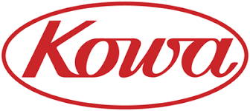


An innovative portfolio led by NCX 470, a derisked product candidate with global potential
 | Stages of Development
3 Product Candidates | Preclinical | Phase 1 | Phase 2 | Phase 3 | NDA | Marketed | Status
NCX 470 | NO-donating bimatoprost eye drops Glaucoma & Ocular Hypertension |  |  |  |  |  |  | Denali topline results expected in H2 2025 Whistler Phase 3b results expected in Q1 2025 Initiation of development for Japan by Kowa Commercial partnership discussions for U.S.
NCX 1728 | NO-donating PDE5 inhibitor Glaucoma (including neuroprotection) & Retinal Conditions |  |  |  |  |  |  | Research and global licensing option agreement with Glaukos
NCX 4251 | Fluticasone propionate nanocrystal susp. Dry Eye |  |  |  |  |  |  | Chinese development
2 Revenue Generating Products | Preclinical | Phase 1 | Phase 2 | Phase 3 | NDA | Marketed | Status
VYZULTA® | Latanoprostene bunod ophthalmic sol. 0.024% Glaucoma & Ocular Hypertension |  |  |  |  |  |  | Recurrent U.S. and international royalty revenue
ZERVIATE® | Cetirizine ophthalmic sol. 0.24% Allergic conjunctivitis |  |  |  |  |  |  | NDA approval obtained and upcoming Chinese commercial launch
Licensed out to in China
Mont Blanc trial completed / Denali Phase 3 trial
and Whistler Phase 3b ongoing
Licensed out to in Japan
Licensed out to. in China
Licensed out to worldwide
Licensed out to in the U.S.
Licensed out to in China and SE Asia

Slide 7
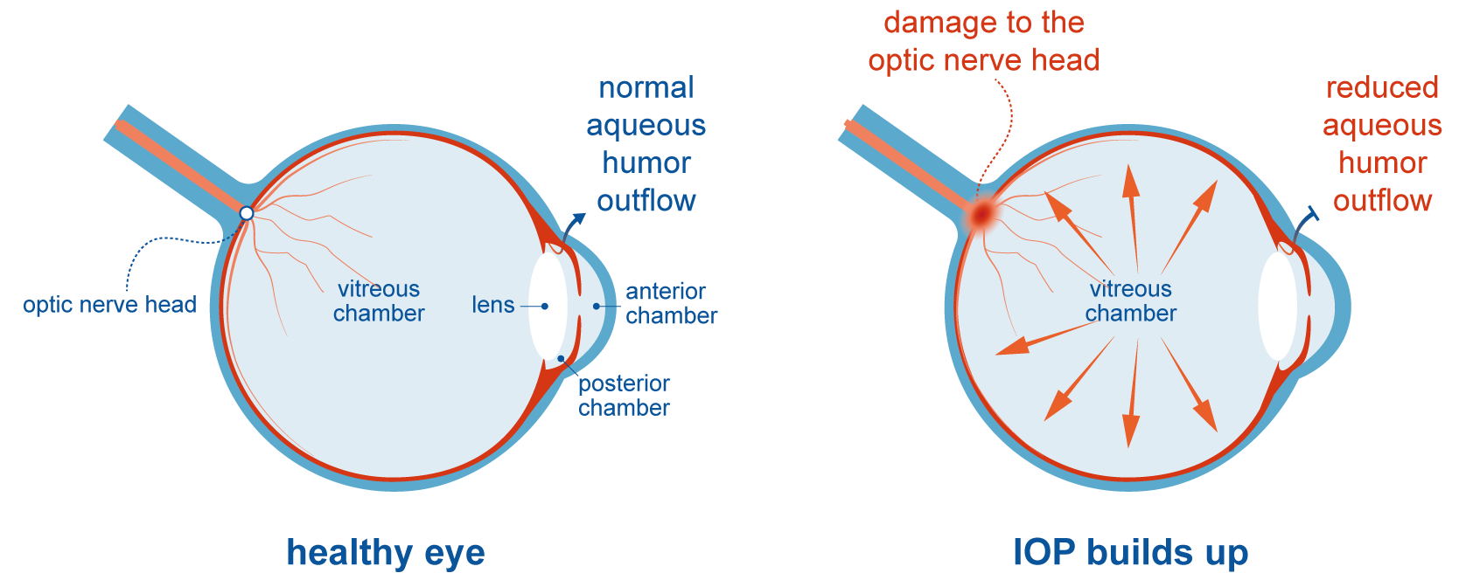
Glaucoma: a worldwide ophthalmic condition with unmet medical needs
Elevated IOP* contributes to irreversible optic nerve damage, leading to progressive vision loss
As published in the landmark EMGT study “…each mmHg of decreased IOP was related to an approximately 10% lowering [of risk of vision loss progression]”¹
Heijl et al. Reduction of intraocular pressure and glaucoma progression: results from the Early Manifest Glaucoma Trial. Arch Ophthalmol. 2002; 120: 1268-1279
*Intraocular Pressure

Slide 8
Unmet medical needs for glaucoma treatment
40% of patients do not achieve their target IOP on existing monotherapies¹ requiring ophthalmologists to adjust or change the medication
Many patients require >1 medication which leads to compliance issues^{2,3}
Tolerability issues with some medications lead to discontinuations, patient management issues, and/or compliance issues⁴
Despite having well established first-line therapies, including the standard-of-care, latanoprost, patients do not react to glaucoma medications in the same way, and therefore ophthalmologists need multiple treatment options
Kass et al, Delaying treatment of ocular hypertension: the ocular hypertension treatment study. Arch Ophthalmol, 2010; 128:276-287
Robin AL et al, Does adjunctive glaucoma treatment therapy affect adherence to the initial primary therapy? Ophthalmology. 2005; 112:863-868
Robin et al, Adherence in glaucoma: Objective measurements of once-daily and adjunctive medication use. Am J Ophthalmol. 2007;144:533-540
Beckers HJM et al. Side effects of commonly used glaucoma medications: comparison of tolerability, chance of discontinuation, and patient satisfaction. Graefe's Archive for Clinical and Experimental Ophthalmology 2008;246(10):1485-90

Slide 9
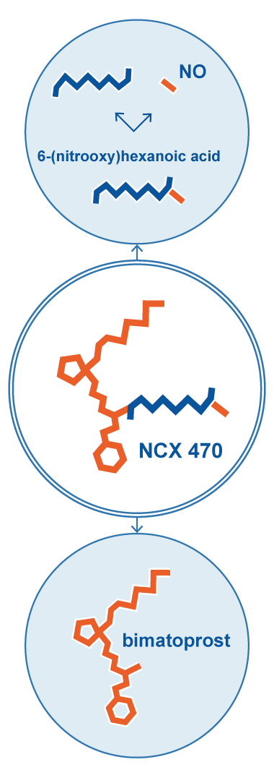
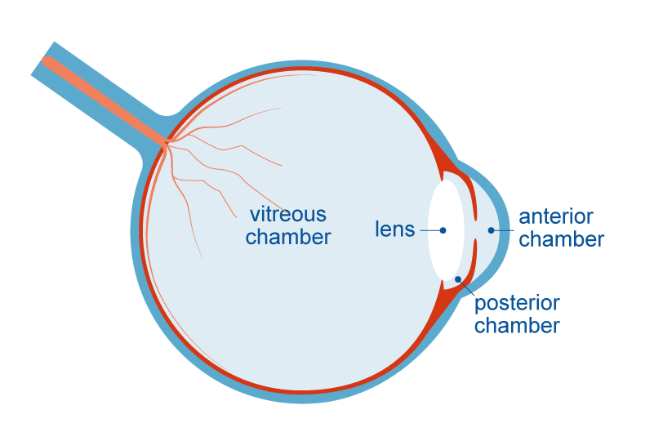
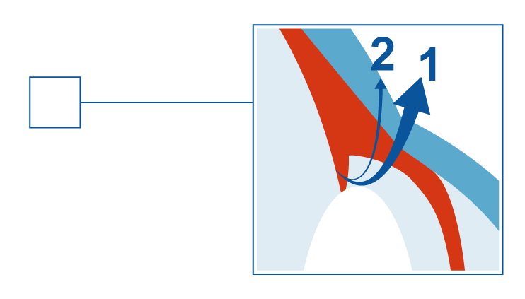
NCX 470 acts through a dual mechanism¹ for IOP lowering
Non-clinical optic nerve/retinal damage models also demonstrate potentially beneficial retinal effects²
Two pathways for aqueous humor outflow
1
Primary or conventional outflow normally accounts for ~60% to 80% of outflow
Stimulated by nitric oxide (NO)
2
Secondary or uveoscleral outflow normally accounts for ~20% to 40% of outflow
Stimulated by
prostaglandins (PGAs)
Same mechanism of action as Nicox’s first commercialized NO-donating product, latanoprostene bunod
Bastia et al. J Ocul Pharmacol Ther. 2022, 38: 496-504

Slide 10
Positive NCX 470 Mont Blanc topline results^{1,2,3}
Phase 3 clinical program intended to support planned U.S. & China NDA submissions
Designed to demonstrate safety and efficacy of NCX 470 0.1% vs. latanoprost 0.005%, defined by IOP reduction from time-matched baseline at pre-established time points
MONT BLANC: Primary objective of
non-inferiority achieved
DENALI: Enrolling subjects
  N=691
  56 clinical sites in the U.S. & one site in China
  Adaptive study design selected the 0.1%
  Second efficacy objective, statistical superiority to latanoprost, was not achieved
  NCX 470 was statistically superior to latanoprost in intraocular pressure reduction from baseline at 4 of the 6 timepoints, and numerically greater at all 6
  N=~670
  ~80 clinical sites in the U.S. & China
  Includes a 12-month safety extension
  Jointly conducted and equally financed with Chinese partner Ocumension Therapeutics
  Topline results expected in H2 2025
Nicox Press release October 31, 2022
Mansberg et al., 2023, World Glaucoma Congress, Abstract # P-339
Fechtner et al., 2023, World Glaucoma Congress, Abstract # P-288

Slide 11
Mont Blanc Phase 3 efficacy trial design¹
Designed to evaluate NCX 470 vs. established therapy, latanoprost
Randomized, controlled, double-masked, parallel design trial. Patients with open angle glaucoma or ocular hypertension were randomized 1:1 to once-daily treatment with NCX 470 0.1% or latanoprost 0.005%
Primary Endpoint:
Mean IOP reduction from time-matched baseline at 8 AM and 4 PM at the week 2, week 6 and month 3 visits
Enrollment:
The trial enrolled 691 patients across all arms (including ~30 patients on NCX 470 0.065% in the adaptive design part)
NCX 470 0.1 % n = 328 patients
Washout*
Latanoprost 0.005 % n = 333 patients
Screening visit and
Eligibility Visit 1
Eligibility Visit 2,
1st dose
Week 6 visit
Month 3
Exit Visit
Week 2 visit
* Wash-out period according to the patient’s previous IOP-lowering treatment
1. This schematic reflects the dosage arms which continued in the trial and do not include the NCX 470 0.065% dose which was only in the adaptive design portion of the trial

Slide 12
Baseline characteristics, demographics and disposition¹
 | NCX 470 0.1% N = 328 | Latanoprost 0.005% N = 333
Mean Diurnal Baseline (8am+4pm) IOP, mmHg, Study Eye (SD) | 26.9 (2.04) | 26.8 (2.02)
Gender, n (%) Female Male | 200 ( 61.0%) 128 ( 39.0%) | 188 ( 56.5%) 145 ( 43.5%)
Age, Years (SD) | 63.6 (10.12) | 62.7 (11.73)
Completed the Study | 314 (95.7%) | 316 (94.9%)
Discontinued Prior to Study Completion | 14 (4.3%) | 17 (5.1%)
Reasons for Discontinuation
Adverse Event | 8 (57.1%) | 6 (35.3%)
Lost to Follow-up | 1 (7.1%) | 4 (23.5%)
Physician Decision | 0 | 0
Sponsor or IRB Decision | 1 (7.1%) | 2 (11.8%)
Protocol Violation | 0 | 1 (5.9%)
Withdrawal by Subject | 3 (21.4%) | 3 (17.6%)
IOP greater than 36 mmHg | 0 | 0
Other | 1 (7.1%) | 1 (5.9%)
As published in the landmark EMGT study “…each mmHg of decreased IOP was related to an approximately 10% lowering [of risk of vision loss progression]”¹
1. This data reflects the dosage arms which continued in the trial and do not include the NCX 470 0.065% dose which was only in the adaptive design portion of the trial.

Slide 13
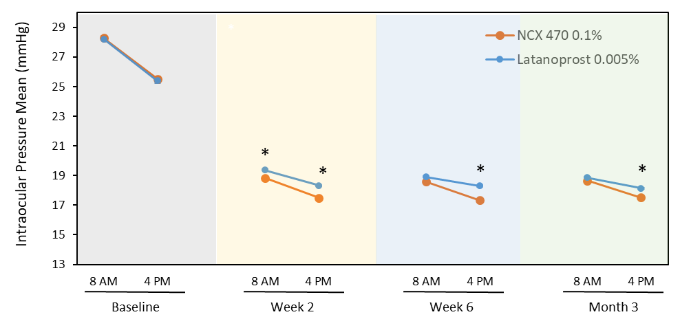
Significant, sustained IOP-lowering effects
IOP-lowering from baseline was 8.0 to 9.7 mmHg for NCX 470 vs. 7.1 to 9.4 mmHg for latanoprost
NCX 470 0.1%: N = 328
Latanoprost 0.005%: N = 333
Denotes statistically significant differences vs latanoprost (p<0.049)
Fechtner et al., AJO, published, 2024 - https://doi.org/10.1016/j.ajo.2024.03.002

Slide 14
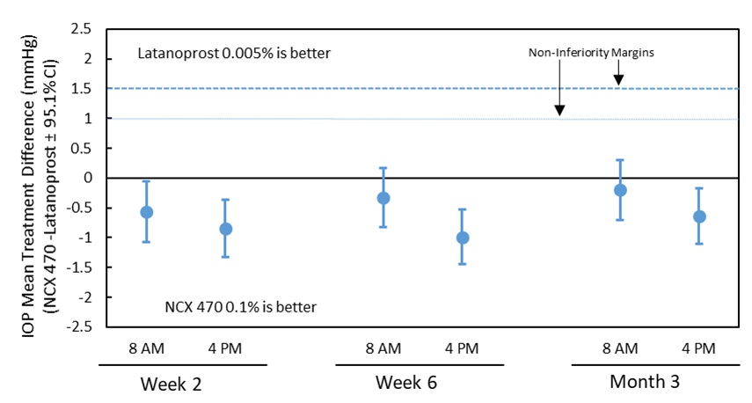
NCX 470 0.1% achieved non-inferiority and demonstrated an IOP-lowering greater than Latanoprost 0.005% of up to 1.0mmHg
To be non-inferior, the treatment difference between NCX 470 and latanoprost had to meet BOTH criteria:
For all 6 timepoints, the upper limit of all confidence intervals (95.1%) were required to be less than or equal to 1.5 mmHg and
At least 4 of the 6 timepoints were required to be less than or equal to 1.0 mmHg
NCX 470 0.1% demonstrated an IOP lowering effect greater than latanoprost 0.005% of up to 1.0 mmHg
*
*
*
*
* Denotes statistically significant differences vs latanoprost (p<0.049)

Slide 15
NCX 470 topline results demonstrate robust efficacy and safety¹
All comparisons are based on NCX 470 0.1% and latanoprost 0.005%
Topline results from this pivotal trial:
IOP-lowering effect from baseline was 8.0 to 9.7 mmHg for NCX 470 vs. 7.1 to 9.4 mmHg for latanoprost
Statistical non-inferiority was met vs. latanoprost in the primary efficacy analysis. This trial therefore met the efficacy requirements for approval in the U.S.
While NCX 470 failed to meet statistical superiority to latanoprost in a pre-specified secondary efficacy analysis of time-matched change from baseline IOP, NCX 470 was numerically superior to latanoprost at all time points and statistically significant (p<0.049) at 4 of 6 timepoints
Data from the post hoc analysis:
In eyes with an initial IOP of ≤ 28 mmHg the IOP-lowering effect from baseline was statistically significantly greater for NCX 470 compared to latanoprost at the majority of timepoints measured
NCX 470 demonstrates a consistent lowering of IOP regardless of the baseline IOP, whereas the reduction in IOP with latanoprost is dependent on the baseline IOP
A statistically significant greater proportion of patients who received NCX 470 showed an IOP reduction of greater than 10 mmHg from baseline, compared to those on latanoprost
NCX 470 was well tolerated
The most common adverse event was ocular hyperemia in 11.9% of NCX 470 patients vs. 3.3% of latanoprost patients
There were no ocular serious adverse events and no treatment-related non-ocular serious adverse events
4.3% of patients on NCX 470 discontinued compared to 5.1% on latanoprost
1. This data reflects the dosage arms which continued in the trial and do not include the NCX 470 0.065% dose which was only in the adaptive design portion of the trial.

Slide 16



NCX 470 – Presentations at key ophthalmology conferences
Poster 1: Intraocular Pressure Reduction with NCX 470 versus Latanoprost Across the Spectrum of Baseline Intraocular Pressures
Poster 2: Intraocular Pressure Reduction with NCX 470 versus Latanoprost In Previously Treated Versus Treatment-Naïve Patients
2024
Effects of NCX 470, a Nitric Oxide (NO)-Donating Bimatoprost, in in-vitro 3D-Human Trabecular Meshwork (TM) / Schlemm's Canal (SC) Co-Culture Tissue Model. Galli et al., 2023, WGC Abstract # P-337
NCX 470, a Nitric Oxide Donating Bimatoprost versus Latanoprost has Greater Proportion of Subjects Achieving ≥10 mmHg IOP Decrease in Phase 3 Trial. Mansberger et al., 2023, WGC Abstract # P-339
NCX 470, a Nitric Oxide Donating Bimatoprost Compared with Latanoprost - Adaptive Design Period Results from the Phase 3 Mont Blanc Clinical Trial. Fechtner et al., 2023, WGC Abstract # P-288
NCX 470, a nitric oxide (NO)-Donating Bimatoprost, Preserves Rabbit eyes from Biochemical and Functional changes associated with endothelin-1 (ET-1)-induced Ischemia/reperfusion Injury of the Optic Nerve and Retina Impagnatiello et al., 2023, ARVO Abstract #2580
NCX 470, a Nitric Oxide Donating Bimatoprost, Demonstrates Non-inferiority to Latanoprost in Phase 3 Mont Blanc Clinical Trial. Fechtner et al., 2023, AGS Abstract #232
2023
Posters are available on the “Publications” section of www.nicox.com

Slide 17
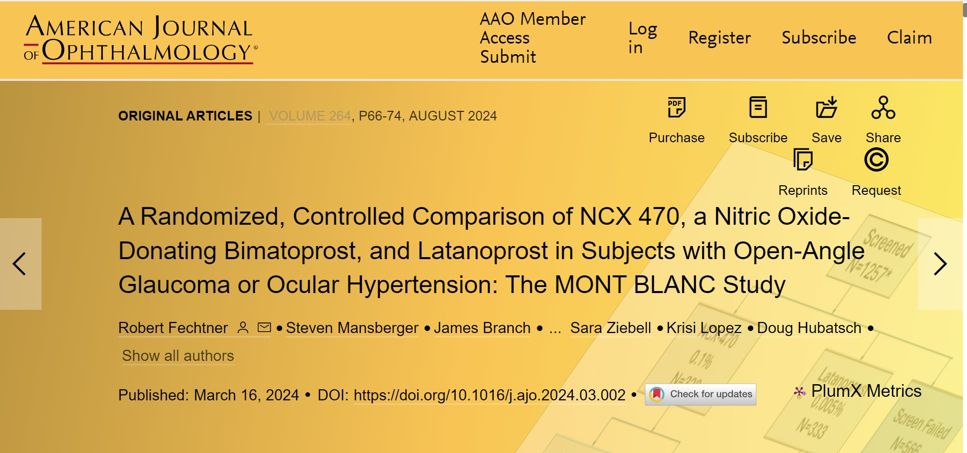
Mont Blanc results published in a prestigious journal
Conclusion: The NO-donating prostaglandin analogue NCX 470 0.1% was well-tolerated and lowered IOP more than latanoprost in subjects with OAG or OHT at all 6 time points. With a dual mechanism of action that enhances both uveoscleral and trabecular outflow, NCX 470 could become an important first-line therapy for IOP reduction in glaucoma.

Slide 18
U.S. glaucoma clinical advisory board with leading experts
DR. ROBERT D. FECHTNER, MD, CHAIRMAN
Professor and Chair of the Department of Ophthalmology at SUNY Upstate Medical University, Syracuse, NY
DR. STEVEN MANSBERGER, MD MPH
Vice-Chair, Senior Scientist, and Director of Glaucoma Services and Ophthalmic Clinical Trials for the Devers Eye Institute in Portland, Oregon. Clinical Professor of Ophthalmology at Oregon Health Science University
DR. SANJAY G. ASRANI, MD
Professor of Ophthalmology at Duke University in Durham, North Carolina, and Director of the Duke Eye Center of Cary and the Duke Glaucoma OCT Reading Center
DR. TOM WALTERS, MD
President of Texan Eye P.A. and Medical Director of Eye LASIK Austin, Advanced Ophthalmic P.A., Keystone Clinical Research
DR. DONALD BUDENZ, MD MPH
Kittner Family Distinguished Professor and Chairman, Department of Ophthalmology, UNC Chapel Hill School of Medicine
DR. ROBERT N. WEINREB, MD
Distinguished Professor and Chair, Ophthalmology, Director of both the Shiley Eye Institute and the Hamilton Glaucoma Center, holder of the Morris Gleich, MD Chair in Glaucoma, and Distinguished Professor of Bioengineering

Slide 19



Value proposition of NCX 470
Novel molecule with competitive positive impact on lowering intraocular pressure (IOP), the leading cause of glaucoma
Positive pivotal Phase 3 topline results from the Mont Blanc trial^{1,2,3}
First non-combination product to demonstrate statistical non-inferiority to a prostaglandin analog in a pivotal trial, thereby meeting the efficacy requirements for U.S. approval
Large and established glaucoma drug market⁴:
~$6 billion worldwide reported
Over 3 million patients and over 36 million prescriptions⁴ in the United States alone with additional safe and effective alternatives to first-line therapy required
Over $300 million global peak net sales forecast⁵ for NCX 470
Only late-stage New Chemical Entity in glaucoma in the U.S.
NCX 470
Nicox Press release October 31, 2022
Mansberg et al., 2023, World Glaucoma Congress, Abstract # P-339
Fechtner et al., 2023, World Glaucoma Congress, Abstract # P-288 b
IQVIATM Analytics Link 2021
Nicox internal estimate – Press Release July 10, 2023

Slide 20
NCX 470 Commercial Potential and Timing
A near-term asset arriving at completion of development
H2 2025
Topline results of Denali Phase 3 Clinical Trial
H1 2026
Submission of New Drug Application in the United States*
H1 2027
Approval and potential launch in the United States*
*Subject to securing a U.S. commercial partner
Composition of matter patent to 2029 expected to be extended to 2034 in the United States and formulation patent to 2039. Additional marketing exclusivity may be available based on the status as a New Chemical Entity
Peak annual net sales potential in the U.S. alone was estimated at between $115 and $165 million¹
Peak annual global net sales of NCX 470 could be over $300 million² within 8 years of the date of launches in the U.S. and China
By year 8 from launch, based on Nicox commissioned market research in 2023, announced here.
Excluding Europe

Slide 21
Chinese partner and largest Nicox shareholder, dedicated to ophthalmology with manufacturing and commercial capabilities
Listed on the Hong Kong stock exchange since 2020
$600 million market cap
Portfolio of 25 products with
10 commercialised
$34 million revenue in 2023 (+55%)
Based in China
Created in 2018
Dedicated to ophthalmology
444 employees, including 232 in commercial
Ocumension’s focus on ophthalmology and their local manufacturing and commercial capabilities makes them the ideal partner for NCX 470 in China
Total of €18 million paid to Nicox in milestones (non-dilutive financing) plus cost contributions to Denali (50%) and Mont Blanc (one Chinese site)
Nicox to receive royalties of 6% to 12% of future net sales on the territories licensed to Ocumension

Slide 22
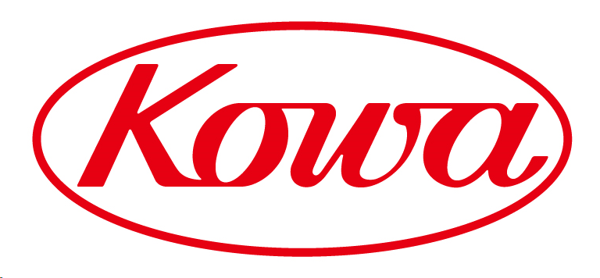
Global enterprise with a strong pharmaceutical business and Japanese glaucoma franchise
Founded in Japan in 1894
Active worldwide in multiple domains including life sciences
~8000 employees with an annual group revenue of $4.9 billion
The pharmaceutical sector is an important one with an international presence
Team of medical representatives in Japan and a franchise in glaucoma
Kowa’s direct commercial experience in glaucoma in Japan positions them as a strong partner for NCX 470
Signed in February 2024 with a €3 million upfront payment to Nicox for exclusive rights to NCX 470 in Japan
Nicox to potentially receive up to €27.5 million in milestones and 7% to 12% royalties on net sales

Slide 23
Future commercialization of NCX 470
To secure the long-term future of the Company
The Company is considering a number of options to ensure the commercialization of NCX 470 and concretize the future strategy:
  New license agreements
  Joint venture structures with companies having complementary products
  M&A
  Extension of the pipeline with other products under license or acquired, with associated funding
Nicox has the team to:
  Complete the development of NCX 470
  Continue our existing collaborations
  Deliver on a long-term strategy

Slide 24


Existing commercial products
VYZULTA
Nicox receives 6% net¹ royalties on global sales – VYZULTA sales increased 35% in 2023 vs. 2022
$5 million net milestone payable to Nicox at $100 million net sales
Patent extended in the United States to 2029
Marketed in >15 countries and territories, including the U.S.
ZERVIATE²
5% to 9% royalties on annual net sales
Potential for up to $17.2 million in sales milestones by Ocumension
Will be manufactured by Ocumension in their state-of-the art Chinese factory and commercialized by their existing sales team
Approved in China in 2024³
Net of royalties payable to Pfizer, per the terms of the contract signed with Pfizer in August 2009
ZERVIATE is also commercialized in the U.S. by Harrow
Ocumension has rights in Chinese and Southeast Asian markets

Slide 25
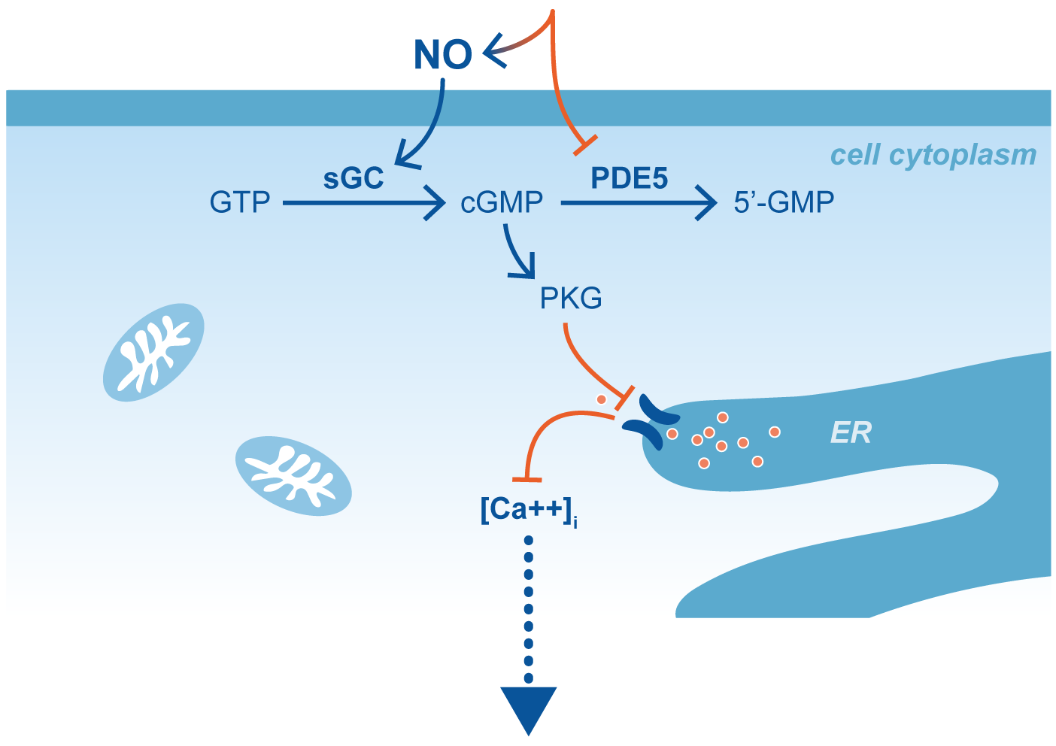
NCX 1728: Research collaboration with Glaukos
NO-donating PDE5 inhibitor
Combining NO-release with PDE5 Inhibition
  MOA for this novel class of molecules is based entirely on NO-mediated activity
  NO-mediated effects are enhanced and prolonged by concomitant phosphodiesterase-5 (PDE5) inhibition within the same molecule
Potential in multiple ophthalmic conditions
  NO is an important mediator in both IOP control and in ocular blood flow and plays a role in a number of retinal conditions where dysfunctional ocular perfusion are key features in disease progression
  Exclusive research and global licensing option agreement
  Pre-clinical research program exploring indications for the treatment of glaucoma, including neuroprotection, and in the treatment of retinal diseases
Muscle cell relaxation
Collaboration with Glaukos
Vasorelaxation
Enhancement of ocular blood flow
Ocular tissues oxygenation
Prevention of retinal damage
MOA = Mechanism of Action GTP = guanosine triphosphate
sGC = soluble guanylate cyclase cGMP = cyclic guanosine monophosphate,
PKG – protein kinase G ER = endoplasmic reticulum
Ca⁺⁺ = Calcium

Slide 26






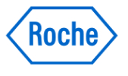




A refocused global leadership team
Gavin Spencer
Chief Executive Officer
Sandrine Gestin
VP, Finance and HR
Doug Hubatsch
EVP, Chief Scientific Officer
Sonia Benhamida
Observer
BlackRock
Damian Marron
Chairman of the Board
Christine Placet
Director
Marc Le Bozec
Director
Gavin Spencer
Chief Executive Officer
Maurizio Petitbon
Observer
BlackRock
Healthcare executive, non-executive Director/Chair and advisor
Experienced CEO and financial leader in the biotech industry
Life Sciences entrepreneur with a background in finance, organization and strategic consulting
More than 25 years of experience in leading strategic and Business Development functions

Slide 27
Financial highlights
Cash balance expected to support current operations through to February 2025
Financial Position and Ownership of the Nicox Group¹
Cash, Cash Equivalents as at 30 June 2024 | €7.8 million
Long term debt as at 30 June 2024² | €20.5 million
Cash runway³ | February 2025
Outstanding Shares⁴ | 63.5 million
Management, Board and Employees Ownership⁵ | 1.6%
Key Institutional Investors⁵ | Ocumension Therapeutics 4.8% HBM Healthcare Investments (Cayman) 3.1%
Analysts coverage
H.C. Wainwright | Yi Chen
1. Figures are non audited. Nicox Group is Nicox SA and its affiliates. 2. This figure does not include the Armistice put option granted in the November 2022 equity financing, payable in the case of a merger by acquisition (fusion par absorption), merger (fusion par création d’une nouvelle société), division (scission), or a change of control within the meaning assigned in article L.233-3 I of the French commercial code (Code de commerce) where the consideration for such transaction is Nicox shares at a value of less than €1.70, the exercise price of the warrants, Armistice can request that Nicox purchases the warrants granted to Armistice at their Black Scholes value (using pre-defined terms). 3. Based exclusively on the development of NCX 470. 4. Existing outstanding shares as of June 21, 2024. 5.To the best of our knowledge, based on share capital issued as of June 21, 2024.

Slide 28

Investment highlights
A proven track record in clinical development and business development
  Two product approvals in the U.S., one in China
  Business development deals in the U.S., Japan, China, and globally with Tier 1 companies
NCX 470, a derisked, late-stage development program
  Positive Mont Blanc Phase 3 efficacy data and well tolerated
  Same-design second Phase 3 trial, Denali, advancing as planned
  Validation by partnerships with Kowa and Ocumension Therapeutics
Large potential market
  ~$6 billion worldwide glaucoma market
  Successful track record of VYZULTA® under partnership with Bausch + Lomb
High strategic transaction potential
  Business development
  M&A

Slide 29
Nicox S.A.
Sundesk Sophia Antipolis
Emerald Square Bâtiment C
rue Evariste Galois,
06410 Biot, France
T: +33 (0)4 97 24 53 00
communications@nicox.com
www.nicox.com
29

